Slide 1
5. Graphs
Part 2

Slide 2
Objectives
Spanning Trees
Prim algorithm
Kruskal algorithm
Eulerian/Hamilton Graphs
Graph Coloring
2

Slide 3
Minimum Spanning Tree (MST)
Introduction
3
Suppose we wish to connect all the computers in a new office building using the least amount of cable. We can model this problem using an undirected, weighted graph G whose vertices represent the computers, and whose edges represent all the possible pairs (u,v) of computers, where the weight w(u,v) of edge (u,v) is equal to the amount of cable needed to connect computer u to computer v. Rather than computing a shortest-path tree from some particular vertex v, we are interested instead in finding a tree T that contains all the vertices of G and has the minimum total weight over all such trees. Algorithms for finding such a tree are the focus of this section.
Notes:
3

Slide 4
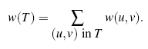
MST - Problem Definition
4
Given an undirected, weighted graph G, we are interested in finding a tree T that contains all the vertices in G and minimizes the sum
A tree, such as this, that contains every vertex of a connected graph G is said to be a spanning tree, and the problem of computing a spanning tree T with smallest
total weight is known as the minimum spanning tree (or MST) problem.
Notes:
4

Slide 5
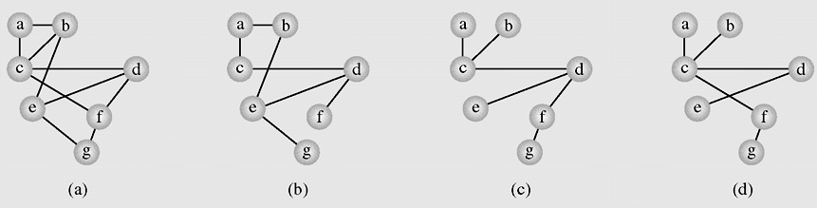
Spanning Tree example
5
In graph theory, a tree is an undirected, connected graph without simple cycles. A spanning tree is a tree that includes all vertices of the original graph
A graph representing the airline connections between seven cities
Two spanning tree of the graph
Notes:
5

Slide 6
Spanning Tree Application
6
Minimum Spanning Trees (MST) are useful in many applications, for example, finding the shortest total connections for a set of edges.
If we are running cable to the nodes, representing cities, and we wish to minimize cable cost, the MST would be a viable option.
An algorithms will be presented: Prim-Jarnık MST algorithm and Kruskal’s Algorithm.

Slide 7
MST algorithms
In this section, we discuss two classic algorithms for solving the MST problem. These algorithms are both applications of the greedy method, which is based on choosing objects to join a growing collection by iteratively picking an object that minimizes some cost function. The first algorithm we discuss is the Prim-Jarn´ık algorithm, which grows the MST from a single root vertex, much in the same way as Dijkstra’s shortest-path algorithm. The second algorithm we discuss is Kruskal’s algorithm, which “grows” the MST in clusters by considering edges in ondecreasing order of their weights.
In order to simplify the description of the algorithms, we assume, in the following, that the input graph G is undirected (that is, all its edges are undirected) and simple (that is, it has no self-loops and no parallel edges). Hence, we denote the edges of G as unordered vertex pairs (u,v).
Notes:
7

Slide 8
MST Prim-Jarnik Algorithm
8
Initialize a tree with a single vertex, chosen arbitrarily from the graph.
Grow the tree by one edge: of the edges that connect the tree to vertices not yet in the tree, find the minimum-weight edge, and transfer it to the tree.
Repeat step 2 (until all vertices are in the tree).
Notes:
|E| = number of edges
|V| = number of vertices
8

Slide 9
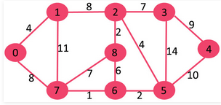
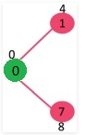

Prim-Jarnik Algorithm demo
9
A spanning tree of graph (a) found with Prim’s algorithm starting with the vertex 0. The vertices are selected in the following order:
0, 1, 7, 6, 5, 2, 8, 3, 9
Notes:
|E| = number of edges
|V| = number of vertices
9

Slide 10
Kruskal Algorithm
10
(A popular algorithm, all edges are ordered by weight, each edge is checked to see whether it can be considered part of the tree. It is added to the tree if no cycle arises after its inclusion)
KruskalAlgorithm(weighted connected undirected graph)
tree = null;
edges = sequence of all edges of graph sorted by weight
for (i = 1; i<=|E| and |tree|<|V| - 1; i++)
if e_i from edges does not form a cycle with edges in tree
add e_i to tree
Notes:
|E| = number of edges
|V| = number of vertices
10

Slide 11
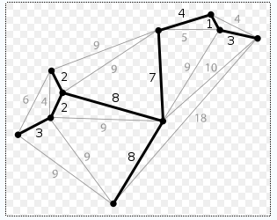
Kruskal Algorithm – demo
11
(a)
A spanning tree of graph (a) found with Kruskal’s algorithm. The vertices are selected in the following order: 1, 2, 2, 3, 3, 4, 7, 8, 8
Notes:
11

Slide 12
Ex.
5
16
D
A
12
B
10
F
7
6
5
15
9
C
E
10
8

Slide 13
Euler cycle and paths
Euler path: a path traversing all the edges of the graph exactly once
Euler cycle: a cycle traversing all the edges of the graph exactly once
No Euler cycle
no Euler path
Has Euler cycle
Has Euler path,
but no Euler cycle

Slide 14
The Bridges of Königsberg
C
Is it possible to start at some
location, travel across all the
bridges without crossing any
bridge twice, and return to
the same starting point?
A
D
B
C
A D
B
Kneiphof island on Pregel river and 7 bridges built in 18-th century in Königsberg town (Kaliningrad).
Rephrasing in terms of Euler cycles:
Notes:
https://mathigon.org/course/graph-theory/bridges

Slide 15
Necessary and sufficient conditions for Euler cycles
Theorem 1: A connected multigraph has an Euler cycle if and only if each of its vertices has even degree.
No Euler cycle
no Euler path
Has Euler cycle
C
A D
B
Euler cycle???
path???
Has Euler path,
but no Euler cycle

Slide 16
Necessary condition for Euler cycle
Theorem 1: A connected multigraph has an Euler cycle if and only if each of its vertices has even degree.
Proof Sketch, PART 1:
Assume the graph has an Euler cycle.
Observe that every time the cycle passes through a vertex, it contributes 2 to the vertex’s degree
(since the cycle enters via an edge incident with this vertex and leaves via another such edge)

Slide 17
Sufficient condition for Euler cycle
Theorem 1: A connected multigraph has an Euler cycle if and only if each of its vertices has even degree.
Proof Sketch, PART 2: Demonstrate an algorithm for finding the Euler cycle in a graph where all vertices have even degree.
Assume every vertex in a multigraph G has even degree. Start at an arbitrary non-isolated vertex v₀, choose an arbitrary edge (v0,v1), then choose an arbitrary unused edge from v1 and so on. Then after a finite number of steps the process will arrive at the starting vertex v0, yielding a cycle with distinct edges.
If the cycle includes all edges of G, this will be an Euler cycle; if not, begin the procedure again from a vertex contained in this cycle and splice the two cycles together; continue until all edges are used.

Slide 18
Note
In the above procedure, once you entered a vertex v, there will always be another unused edge to exit v because v has an even degree and only an even number of the edges incident with it had been used before you entered it.
The only edge from which you may not be able to exit after entering it is v₀ (because an odd number of edges incident with v₀ have been used as you didn’t enter it at the beginning) , but if you have reached v₀, then you have already constructed a required cycle.

Slide 19
A procedure for constructing an Euler cycle
Algorithm: Euler(G)
//Input: Connected graph G with all vertices having even degrees
//Output: Euler cycle
Construct a cycle in G
Remove all the edges of cycle from G to get subgraph H
while H has edges
find a non-isolated vertex v that is both in cycle and in H
//the existence of such a vertex is guaranteed by G’s connectivity
construct subcycle in H
splice subcycle into cycle at v
remove all the edges of subcycle from H
return cycle

Slide 20
Example
1 3 5 7
2 4 6 8
G
1 3 5 7
2 4 6 8
1 3 5 7
2 4 6 8
cycle
1231
H
1 3 5 7
2 4 6 8
subcycle
34653
splicing
34653 into
1231
1 3 5 7
2 4 6 8
1 3 5 7
2 4 6 8
H

Slide 21
Example (cont.)
1 3 5 7
2 4 6 8
1 3 5 7
2 4 6 8
H
splicing
6786 into
12346531
1 3 5 7
2 4 6 8
1 3 5 7
2 4 6 8
H
Euler cycle obtained
12346786531

Slide 22
Algorithm for finding an Euler cycle from the vertex X using stack
Algorithm: Euler(G)
//Input: Connected graph G with all vertices having even degrees
//Output: Euler cycle
declare a stack S of characters
declare empty array E (which will contain Euler cycle)
push the vertex X to S
while (S is not empty){
ch = top element of the stack S
if ch is isolated then remove it from the stack and put it to E
else
select the first vertex Y (by alphabet order), which is adjacent
to ch, push Y to S and remove the edge (ch,Y) from the graph
}
the last array E obtained is an Euler cycle of the graph

Slide 23
Necessary and sufficient conditions for Euler paths
Theorem 2. A connected multigraph has an Euler path but not an Euler cycle if and only if it has exactly two vertices of odd degree.

Slide 24
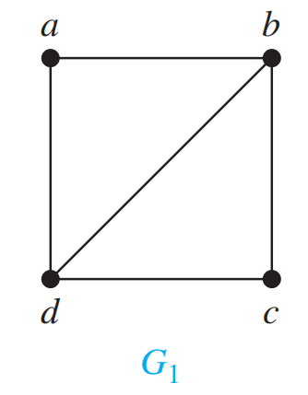
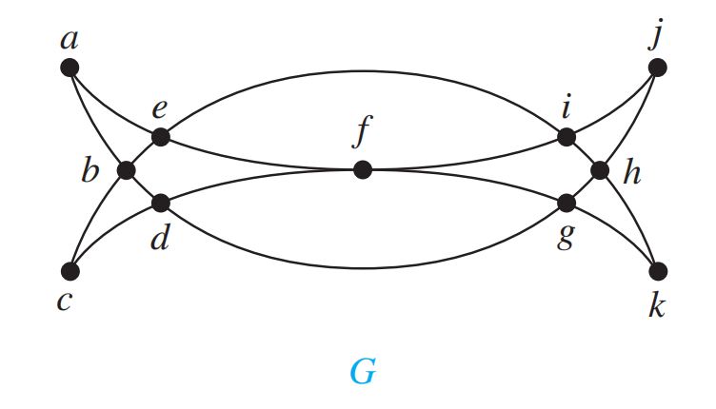
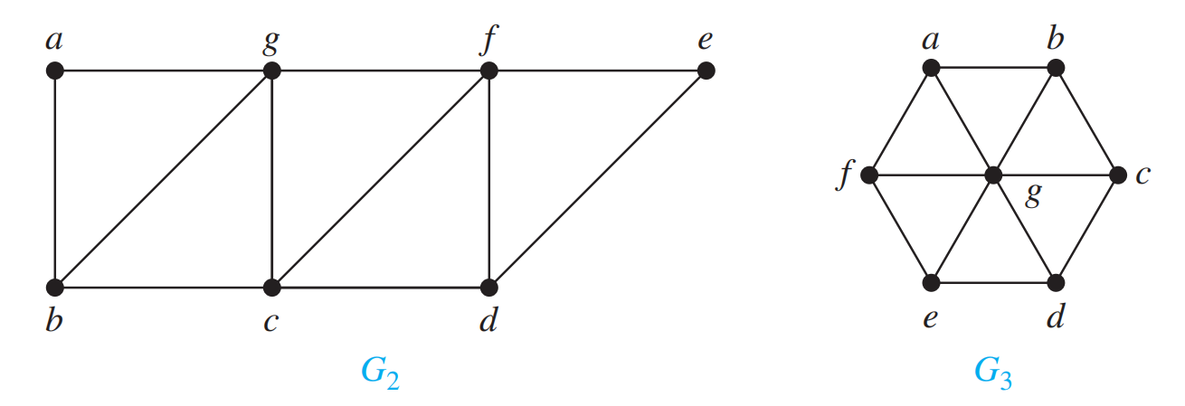
Exercise - Euler cycle/path

Slide 25
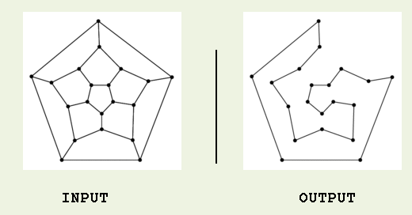
Hamilton paths and cycles - 1
Hamilton cycle: visits every vertex of the graph exactly once before returning, as the last step, to the starting vertex.
Examples:
Hamilton path: visits every vertex of the graph exactly once.

Slide 26
Finding Hamilton’s cycles using Backtracking
Given the graph G = (V,E) and X is a vertex of G.
Suppose there exists at least one Hamilton Cycle for the graph. The following is a backtracking algorithm for finding one Hamilton cycle from the vertex X:
Declare an empty array H (which will contain Hamilton cycle)
(1) Put the vertex X to H
(2) Check if H is a Hamilton cycle then stop, else go to (3)
(3) Consider the last vertex Y in H:
If there is/are vertex(es) adjacent to Y, select an adjacent vertex Z and put it to H.
If there no adjacent vertex, remove Y from H and denote it as a bad selection (so you do not select it in the same way again).
Go to (2).

Slide 27
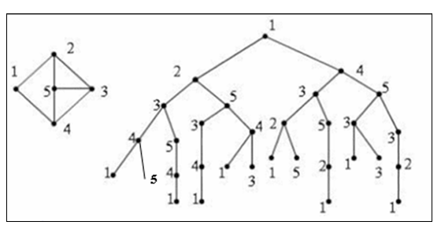
List all Hamilton’s cycles using Backtracking

Slide 28
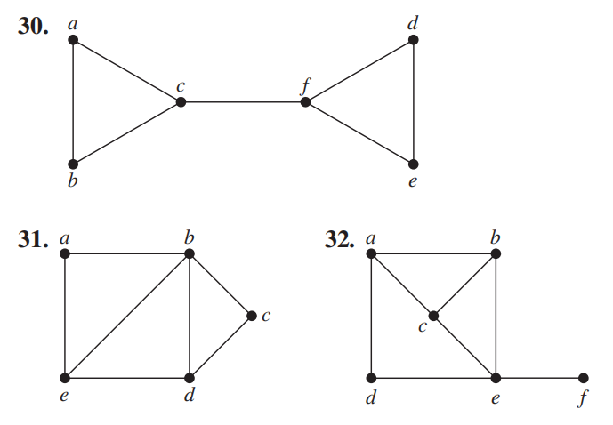
Exercise

Slide 29
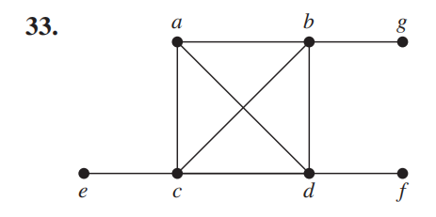
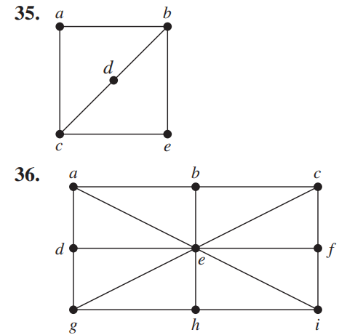
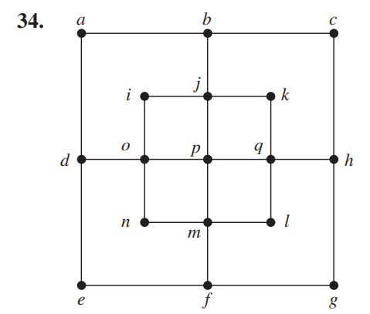
Exercise

Slide 30
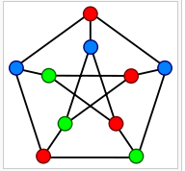
Graph coloring - 1
In graph theory, graph coloring is a way of coloring the vertices of a graph such that no two adjacent vertices share the same color.
The chromatic number of a graph is the minimum number of colors one can use to color the vertices of the graph so that no two adjacent vertices are the same color.
If the chromatic number of the graph G is denoted by χ(G). A graph for which k = χ(G) is called k-colorable. For a complete
graph χ(K_{n})=n, χ(C_{2n})=2, χ(C_{2n+1})=3; and for bipartite graph χ(G)≤ 2.
Determining a chromatic number of a graph G is an NP-complete problem.

Slide 31
Graph coloring - 2
Sequential coloring establishes the sequence of vertices and a sequence of colors before coloring them, and then color the next vertex with the lowest number possible
sequentialColoringAlgorithm(graph = (V, E))
put vertices in a certain order v_{P1}, v_{P2}, . . . , v_{Pv} ;
put colors in a certain order c₁, c₂, . . . , c_{k};
for i = 1 to |V|
j = the smallest index of color that doesn’t appear in any neighbor of v_{Pi};
color(v_{Pi}) = c_{j};
The complexity of this algorithm is O(|V|²)

Slide 32
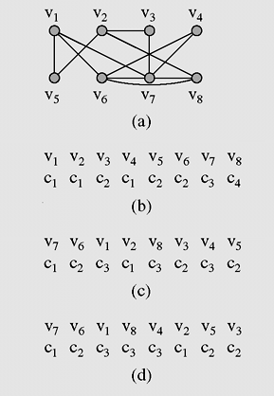
Graph Coloring - 3
(a) A graph used for coloring;
(b) colors assigned to vertices with the sequential coloring algorithm that orders vertices by index number; (c) vertices are put in the largest first sequence;
(d) graph coloring obtained with the Brélaz algorithm

Slide 33
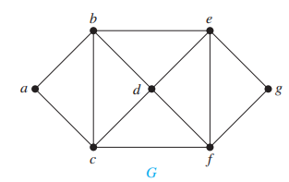
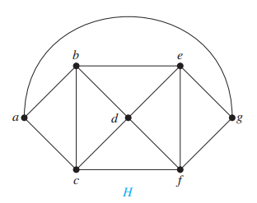
Exercise
Given a graph below and colors numbered 1, 2, 3,... are assigned to vertices with the sequential coloring algorithm that orders vertices in decreasing order of their degrees, (i.e. vertices are put in the largest first sequence)
What is the color of the vertex g in the graphs G and H?

Slide 34
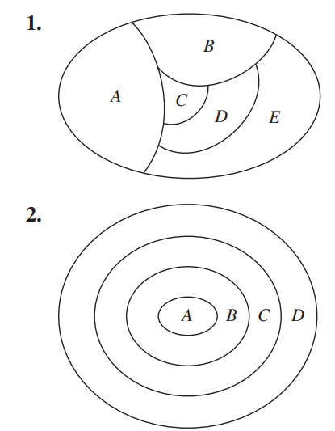
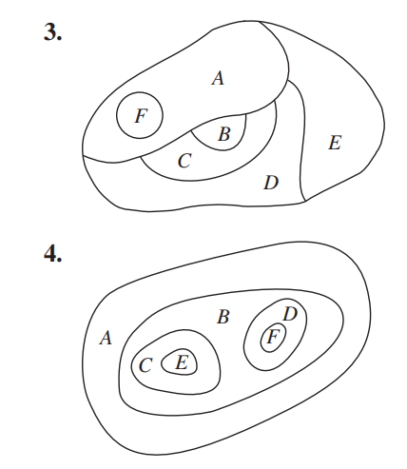
Exercise

Slide 35
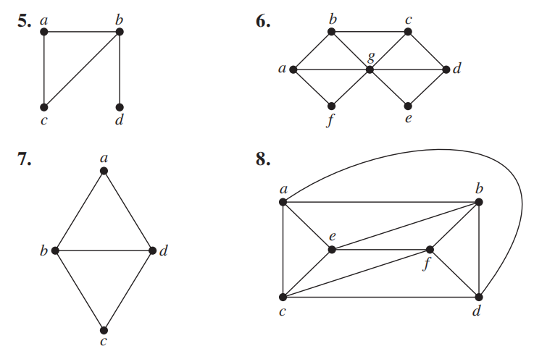
Exercise

Slide 36
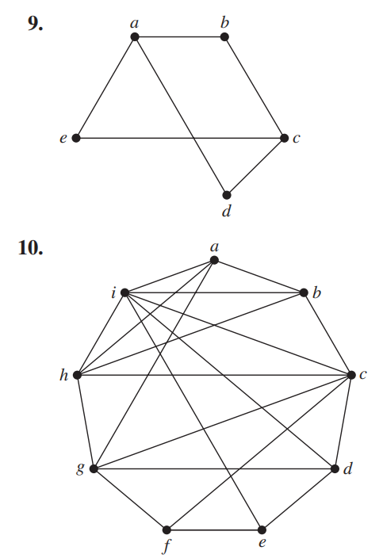
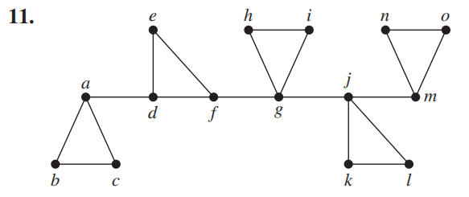
Exercise

Slide 37
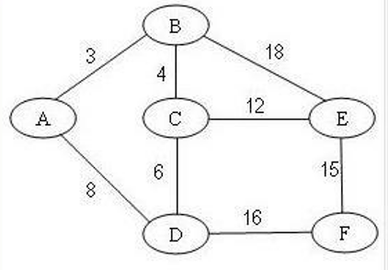
Exercise
Given a weighted graph below. What is the total edge-weight of the minimum spanning tree of G?

Slide 38
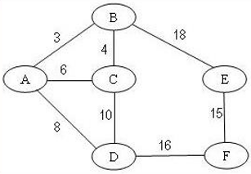
Exercise
Given a weighted graph below. What is the total edge-weight of the minimum spanning tree of G?

Slide 39
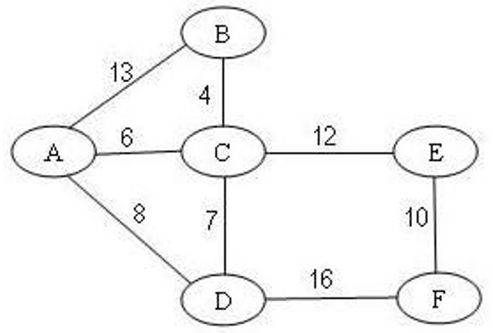
Exercise
Given a weighted graph below. What is the total edge-weight of the minimum spanning tree of G?
A. 35
B. 42
C. 39
D. 45
E. 40
Notes:
C

Slide 40
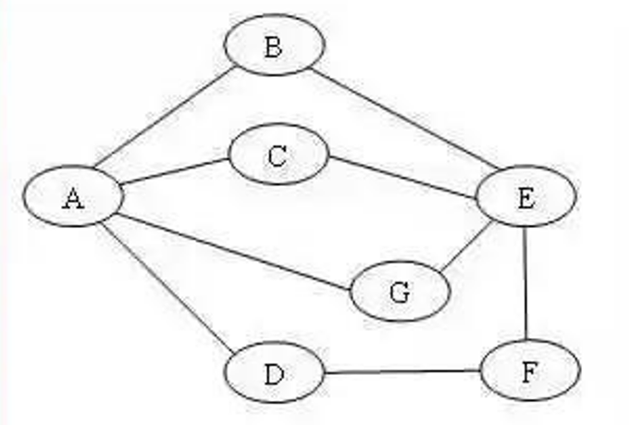
Exercise
Given a graph below and colors numbered 1, 2, 3,... are assigned to vertices with the sequential coloring algorithm that orders vertices in decreasing order of their degrees, (i.e. vertices are put in the largest first sequence)
What is the color of the vertex G?
Notes:
1. 2

Slide 41
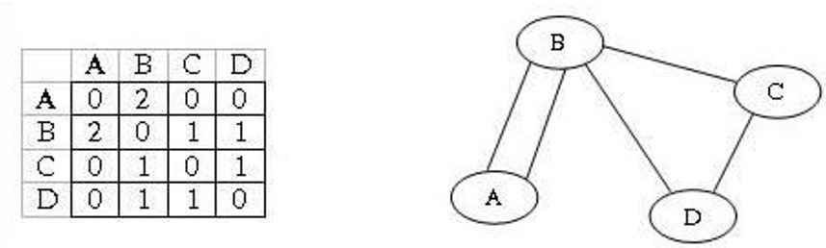
Exercise
Suppose the graph G = (V.E) satisfies the conditions for the existence of an Eulerian cycle. The following is an algorithm for finding
Euler cycle from the vertex X using stack:
declare a stack S of characters (a vertex is labeled by a character)
declare an empty array E (which will contain Euler cycle)
push the vertex X to S
while(S is not empty)
{ ch = top element of the stack S
if ch is isolated then: remove it from the stack and put it to E
else: select the first vertex Y (by alphabet order) which is adjacent to ch
push Y to S and remove the edge (ch,Y) from the graph
}
the last array E obtained is an Euler cycle of the graph
Suppose a multigraph G is given below (view picture). Which of the followings is the Euler cycle from the vertex A, created by above algorithm?

Slide 42
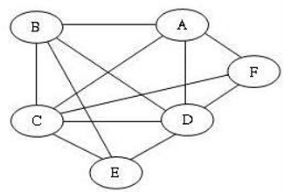
Exercise
Given the graph G = (V.E) and X is a vertex of G. Suppose there exists at least one Hamilton Cycle for the graph. The following is a backtracking algorithm for finding
the first Hamilton cycle from the vertex X:
declare an empty array H (which will contain Hamilton cycle)
(1) Put the vertex X to H
(2) Check if H is a Hamilton cycle then stop.
else go to (3)
(3) Consider the last vertex Y in H.
if there is/are vertex(es) adjacent to Y: select the first adjacent vertex Z (by alphabet order) and put it to H.
If there no adjacent vertex, remove Y from H and denote it as a bad selection (so you do not select it in the same way again).
Go to (2).
Suppose a G is given below (view picture). Which of the followings is the Hamilton cycle from the vertex C. created by above algorithm?
A. C. A. B. E. D. F. C
B. C. E. B. D. A. F. C
C. C. F. D. E. B. A. C
D. C. E. D. F. A. B. C
E. C. B. A. F. D. E. C

Slide 43
Summary
43
Spanning Trees
Prim algorithm
Kruskal algorithm
Eulerian and Hamilton Graphs
Graph coloring

Slide 44
Reading at home
Text book: Data Structures and Algorithms in Java
14.7 Minimum Spanning Trees - 662
14.7.1 Prim-Jarn´ık Algorithm - 664
14.7.2 Kruskal’s Algorithm - 667
(Euler's tour and Euler's cycle, exercise C.14.5.2)

Slide 45
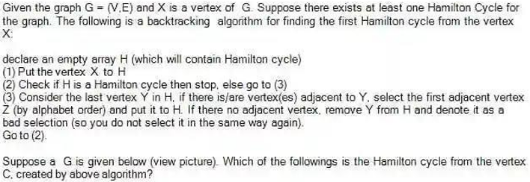
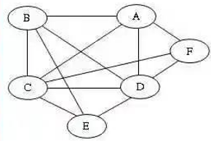
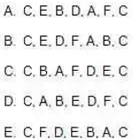
Exercise
Notes:
D

